Slide 2
Guidelines
All texts and descriptions should be in PPT in English (eventual winners will be able to present Slovak / Czech).
Do not use animations within slides or animated slide transitions.
Display pictorial elements in graphics that are sufficiently visible on a classic screen (unblurred, legible).
Observe the maximum number of slides for each block.
Minimum size of font is 14.
Do not use too much text, if a more extensive description is needed to understand the idea, write it briefly in the notes to the slide.
Content/topic is not evaluated criterium, important is application of Lean / Agile / Project management methods & tools. – NOT WHAT, BUT HOW –

Slide 3
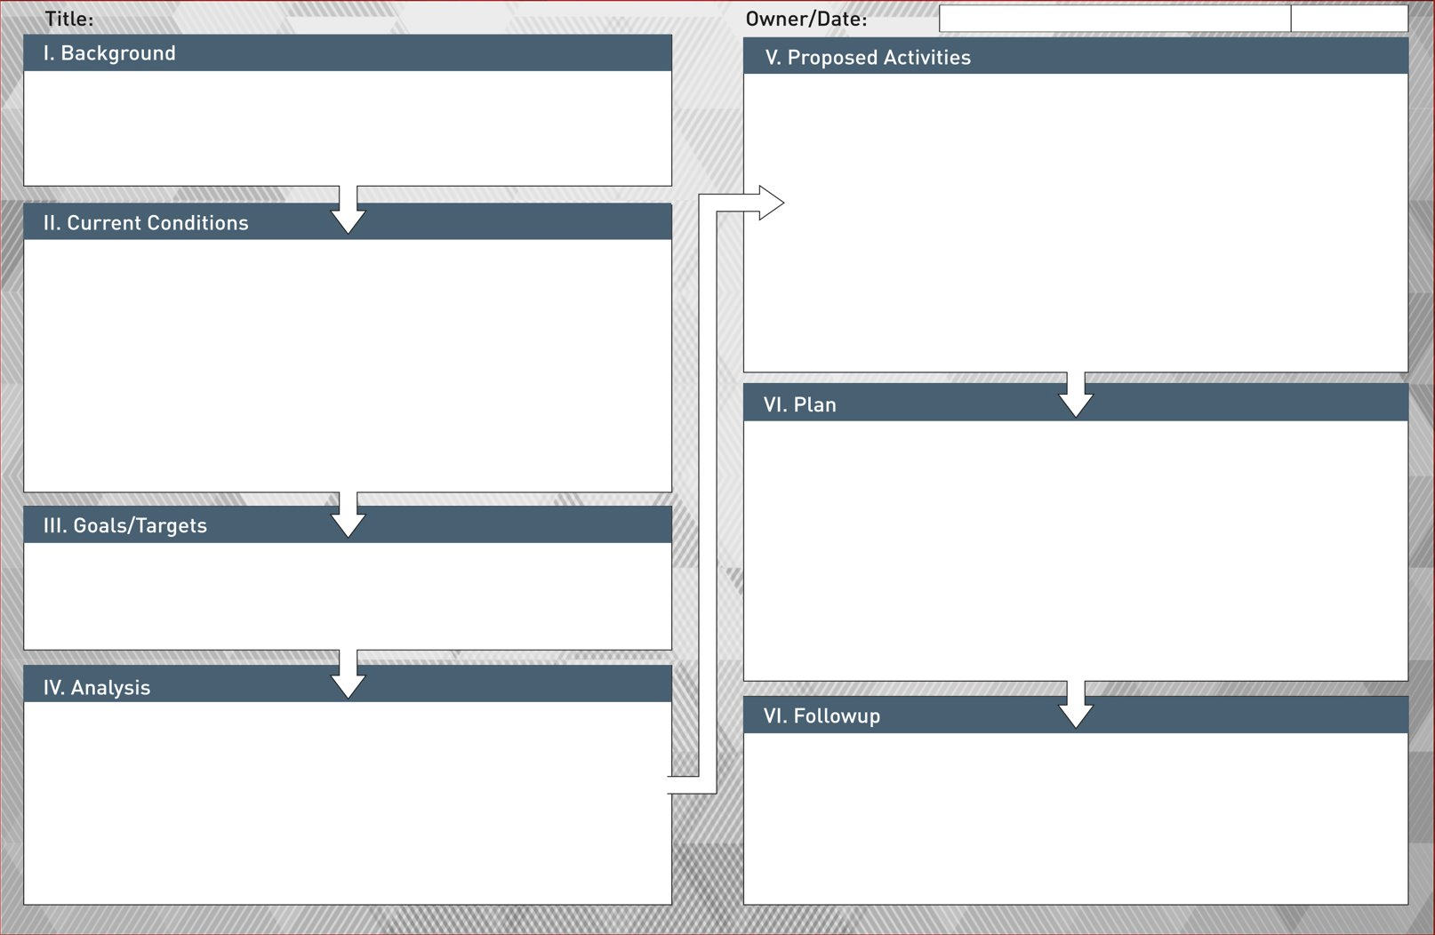
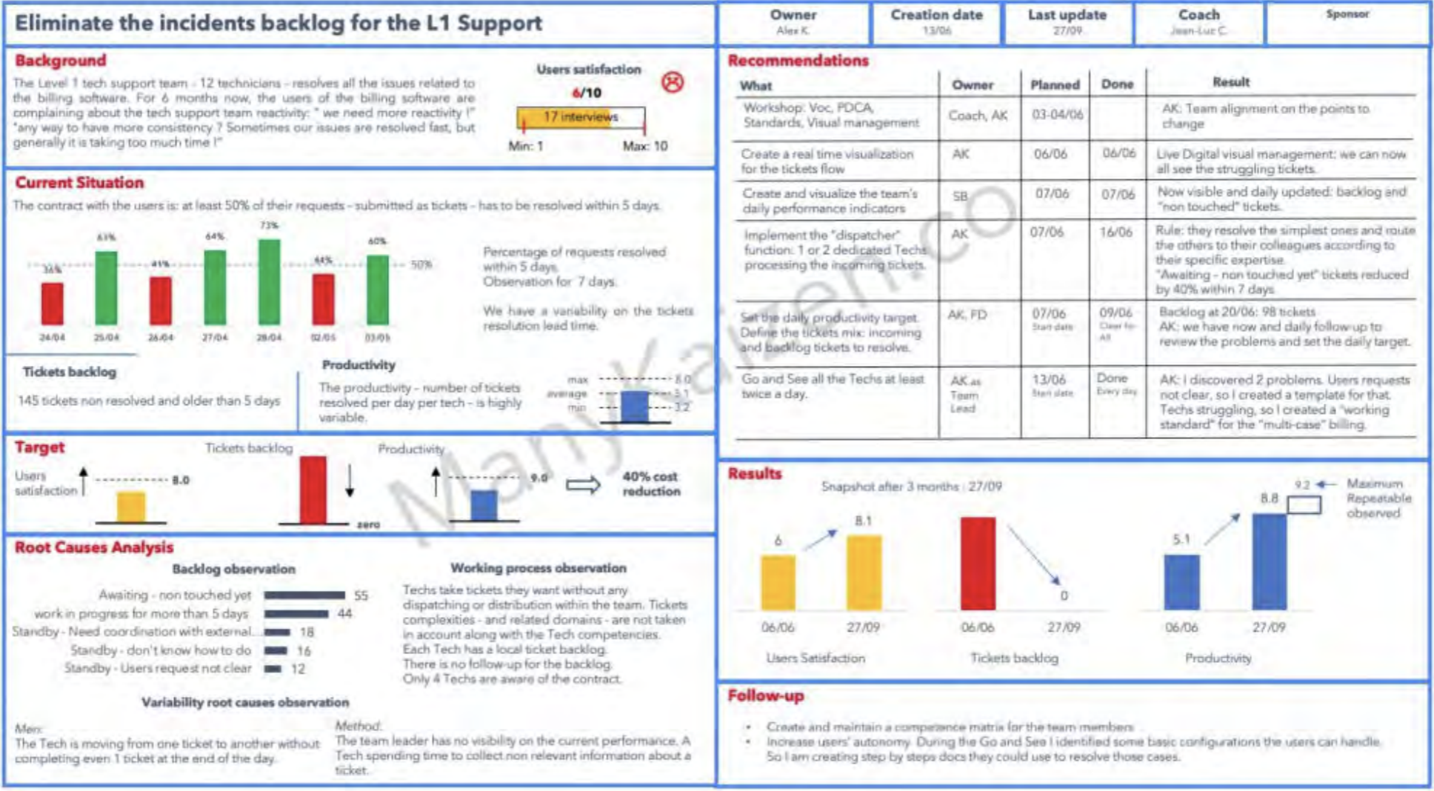
A3
Management Summary
Prepare a short summary slide of the project (this will be used by the awards panel also the winning projects, will be displayed on a large screen for all).
Get inspired by the typical headings of an A3 report:
I. Background
II. Current Conditions
III. Goals / Targets
IV. Analyses
V. Proposed Activities / Countermeasures
VI. Implementation Plan
VII. Results and Follow up
Max 1 slide

Slide 4
Problem or Opportunity
Well defined problem / opportunity statement demonstrating why this project was selected (e.g. benefit effort based on data from business, financial, customer or process related impact).
Max 1 slide

Slide 5
Target
What SMART target(s) were set by management?
Max 1 slide (Can be combined with previous slide Problem or Opportunity).

Slide 6
Current State
Graph or other representation of the status before the improvement.
Max 2 slides

Slide 7
Root Cause
Demonstration of adequate Root Cause Analysis tool selection and application.
Max 3 slides

Slide 8
Countermeasure(s)
What innovative actions to eliminate the root cause(s) were identified and selected?
Max 3 slides

Slide 9
Implementation + Duration
Demonstrate use of Lean tools + was the project completed to a plan justified by the complexity involved? Consider also budget and resource planning if relevant.
Max 1 slide

Slide 10
Result
% of target achieved + a graph or other monitoring tool showing the before and after status.
Max 1 slide

Slide 11
Standardisation
How will the improvement be maintained long-term?
Max 1 slide

Slide 12
Expansion
Are plans in place to leverage the project across the organisation?
Max 1 slide

